Slide 1

Version Control
git
ITI - Day 1

Slide 2

Content
Introduction to VCS
Centralized VCS
1
2
What it is, use cases and advantages
The structure of the centralized VCS
Distributed VCS
Git & GitHub
3
4
The structure of the distributed VCS
History, advantages and hands-on

Slide 3
Introduction To VCS
What it is, use cases
and advantages

Slide 4

What is version control?
Version control, also known as source control, is the practice of tracking and managing changes to software code.
Version control software keeps track of every modification to the code in a special kind of database. If a mistake is made, developers can turn back the clock and compare earlier versions of the code to help fix the mistake.

Slide 5
Why use Version Control ?
1
Helps teams collaborate around the world
2
Accelerates product delivery
3
You can version and backup your code
4
Keeping Track of All the Modifications Made to the Code
5
Working on a new features without affecting the working code

Slide 6
Version Control Features
1
Synchronization
2
Backup & Restore
3
Short-term undo
4
Long-term undo
5
Track Changes
6
Track Ownership
7
Sandboxing
8
Branching and merging

Slide 7
Version Control Terminologies
Repository
Or Repo
Server
Client
Working Copy
Master/Main

Slide 8
Match The VCS Terminologies
Repository (Repo)
1
A
The computer connecting to the repo
Server
2
B
Local directory of files, where you make changes
Client
3
C
The database storing the files
Working Copy
4
D
The primary location for code in the repo
Master/Main
5
E
The computer storing the repo

Slide 9
The VCS Terminologies Solution
Repository (Repo)
1
A
The computer connecting to the repo
Server
2
B
Local directory of files, where you make changes
Client
3
C
The database storing the files
Working Copy
4
D
The primary location for code in the repo
Master/Main
5
E
The computer storing the repo

Slide 10
Centralized VCS
The structure of
the centralized VCS

Slide 11
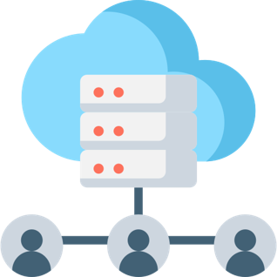
Centralized VCS
Centralized version control systems are based on the idea that there is a single “central” copy of your project on a server, and programmers will “commit” their changes to this central copy.
“Committing” a change simply means recording the change in the central system. Other programmers can then see this change. They can also pull down the change, and the version control tool will automatically update the contents of any files that were changed.

Slide 12
Centralized
Version Control
System
Commit
Commit
Central Repository
Update
Commit
Commit
Update
Update
Update
Developer
Developer
Developer
Developer

Slide 13
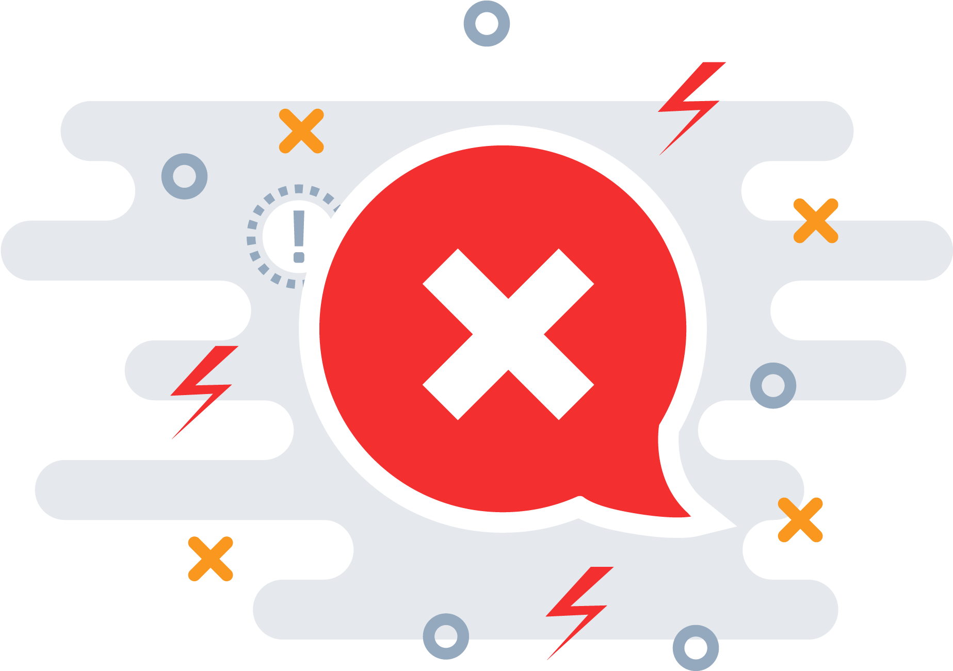
Disadvantages
If the main server goes down, developers can’t save versioned changes.
Need internet connection to commit the changes.
If the central database is corrupted, the entire history could be lost.

Slide 14


Centralized VCS Examples
Concurrent
Version System
Subversion

Slide 15
Distributed VCS
The structure of
the distributed VCS

Slide 16
Distributed VCS
These systems do not necessarily rely on a central server to store
all the versions of a project’s files. Instead, every developer
“clones” a copy of a repository and has the full history of the
project on their own hard drive.
The act of getting new changes from a repository is usually called
“pulling”, and the act of moving your own changes to a repository
is called “pushing”. In both cases, you move changesets (changes
to files groups as coherent wholes), not single-file diffs.

Slide 17
Distributed
Version Control
System
Push
Remote Repository
Push
Pull
Pull
Local Repo
Push
Local Repo
Commit
Commit
Pull
Local Repo
Update
Commit
Update
Developer
Developer
Update
Developer

Slide 18
Advantages
Performing actions other than pushing and pulling changesets is extremely fast because the tool only needs to access the hard drive, not a remote server.
Committing new changesets can be done locally without anyone else seeing them. Once you have a group of changesets ready, you can push all of them at once.

Slide 19
Advantages - Cont'd
Everything but pushing and pulling can be done without an internet connection. So you can work on a plane, and you won’t be forced to commit several bugfixes as one big changeset.
Since each programmer has a full copy of the project repository, they can share changes with one or two other people at a time if they want to get some feedback before showing the changes to everyone.

Slide 20
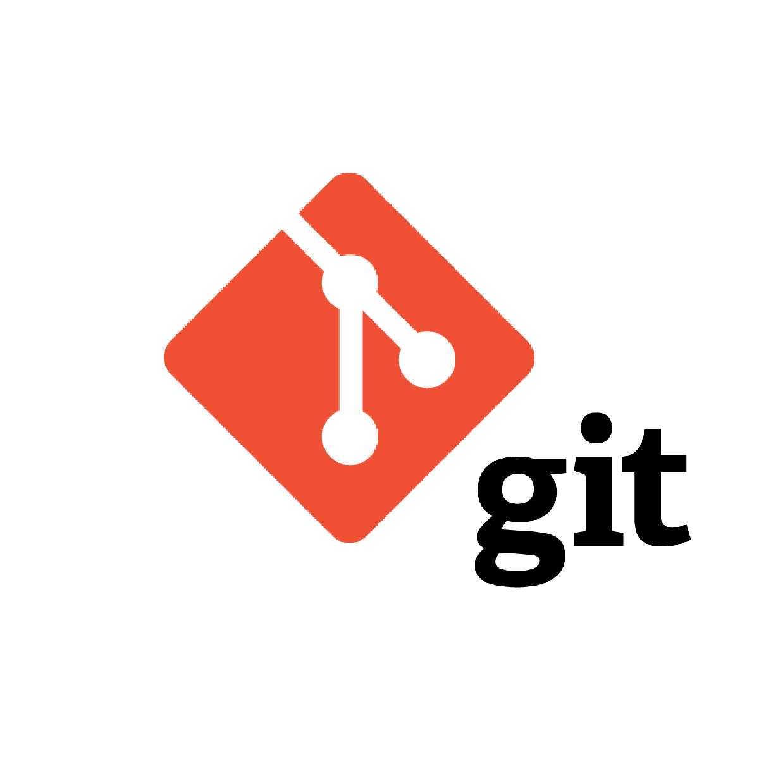
Distributed VCS Examples

Slide 21
Git & GitHub
History, advantages
and hands-on

Slide 22
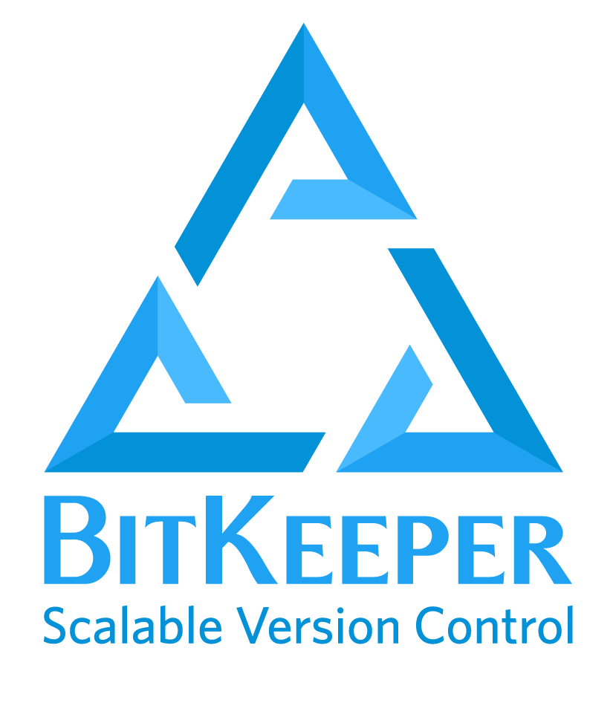

Git History
2002
Linux kernel project began using BitKeeper
2005
Linux kernel project stopped using BitKeeper
2005
Linus Torvalds started working on a new DVCS called Git

Slide 23
Simple design
Speed
Fully distributed
The Goals of Git
Able to handle large projects like the Linux kernel efficiently
Strong support for non-linear development

Slide 24
Every Operation is Local
Most operations in Git only need local files and resources to operate, generally no information needed from another computer on your network.
For example: to browse the history of the project, Git doesn’t need to go out to the server to get the history and display it for you, it simply reads it directly from your local database.

Slide 25
Git Integrity
The Git Version Control System uses SHA-1 checksums on the contents of all change commits. In fact, the checksum is used as commit identifier and commonly referred to as "the SHA". Git's checksums include metadata about the commit including the author, date, and the previous commit's SHA.
Git assures the integrity of the data being stored by using checksums as identifiers. If someone were to try to alter a commit or its meta data, it would change the SHA used to identify it. It would become a different commit.

Slide 26
The Three Git States
Git has three main states that your files can reside in:
Modified means that you have changed the file but have not committed it to your database yet.
Committed means that the data is safely stored in your local database.
Staged means that you have marked a modified file in its current version to go into your next commit snapshot.

Slide 27
The Three Git States
Remote Repository
Local Machine
Working Dir
Staging Area
Local Repo
git add
git commit
git push
git checkout
git pull

Slide 28
First Time Git Setup
The first thing you should do when you install Git is to set your user name and email address.
This is important because every Git commit uses this information, and it’s immutably baked into commits you start creating.
git config --global user.name “your name”
git config --global user.email “your e-mail”
You can also set your default editor and colorize the output:
git config --global core.editor vi
git config --global color.ui true

Slide 29
Git SSH Keys
SSH keys come in pairs, public key that gets shared with services like GitHub and a private key that is stored only on your computer. If the keys match, you’re granted access.
Generate a new SSH key pairs
ssh-keygen -t ed25519 -C "your e-mail"
Copy the public key to your GitHub account
cat ~/.ssh/id_ed25519.pub

Slide 30
Starting a Repo
mkdir pyhton_project
Make a directory
cd python_project
Change directory to the above directory
git init
Initialize an empty Git repository
ls -a
List all the files & dir and the hidden files & dir

Slide 31
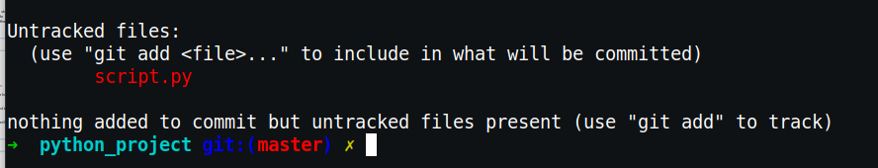
Create a New File
touch script.py
Create a new file called script.py
git status

Slide 32
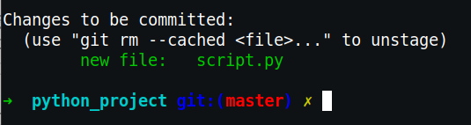
Add to Staging Area
git add script.py
Staging the script.py file
git status

Slide 33

Commit changes
git commit -m “the first commit”
Commit the changes
git status

Slide 34
Amend to a Commit
git commit --amend -m “your new msg”
Maybe you forgot to add a file
The above command will amend
the added change to the last commit

Slide 35
Add & Commit
git commit -a -m “the first commit”
Add the changes & commit the changes in one line
But , notice that this command doesn’t add new files
It only works with the changes that made inside the files itself

Slide 36
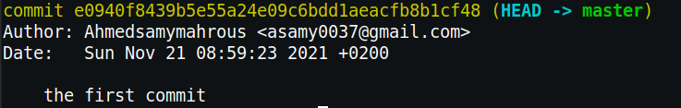
Git Logs
git log

Slide 37
Git Diff
git diff
Show the unstaged differences since the last commit
git diff --staged
Show the staged differences since the last commit

Slide 38
Unstaging changes
git reset HEAD script.py
To unstage the changes
git restore --staged script.py
To unstage the changes

Slide 39
Undoing a Comment
git reset --soft HEAD^
Delete the last commit and git back to the staging area
git reset --soft HEAD^^
Delete the last 2 commits and git back to the staging area
git reset --hard HEAD^
Delete the commit and the change from staging area and delete from working copy

Slide 40
Add / Remove Remote Repo
git remote add origin https://github.com/Ahmedsamymahrous/any_repo
To add a remote repository
git remote -v
To list the remote repositories

Slide 41
Push / Pull Remote Repo
git push origin master
To push the local changes to the remote repo
git pull origin master
To get the changes that made by others

Slide 42
Clone a Remote Repo
Git clone https://github.com/****/*****
To clone the entire repository to your
local machine in a new directory

Slide 43
Lab 1
Install Git.
Create an account on GitHub.
Accept my contribution invitation from Gmail, and clone the repository to your computer.
Edit the repo by adding new file including your name and email, and push the changes.
Create a new local repo and a remote repo on GitHub, then make a file contains your full name, then push it to the remote repo, and send an invitation to me (ahmedibrahem22322@gmail.com).

Slide 44

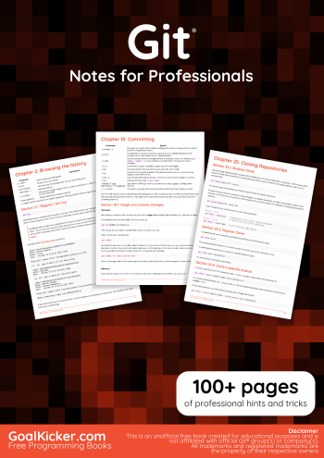
R
E
S
O
U
R
C
E
S
Pro Git - Second Edition
Git - Notes for Professionals

Slide 45
Thanks!
Do you have any questions?

